Slide 1
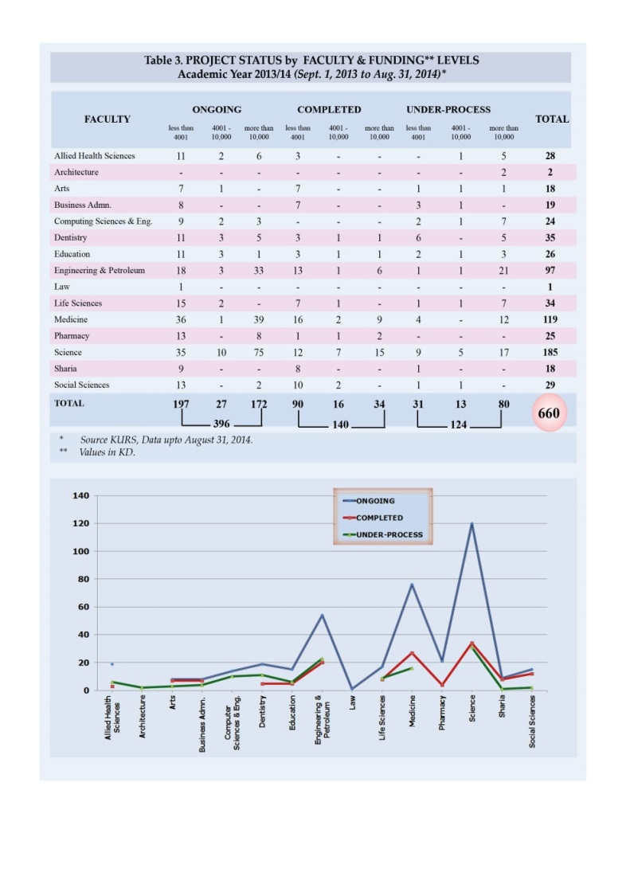
Title of Research Study(Arial Bold 54-60) Researcher(s)/Author(s)Name(s)(Arial Bold 32-36)
University/Department / Faculty (Arial Bold 28-32)
Abstract (Arial 28-32)
Oral cancer, widely prevalent in developed and developing world, is also linked to widely prevalent in developed and developing world……………….. (Text in Arial 24)
Introduction (Arial Bold 40-44)
Oral cancer, widely prevalent in developed and developing world (Text in Arial 20-24)
Results (Arial Bold 40-44)
Oral cancer, widely prevalent in developed and developing world, is also linked to demographics as age, gender and ethnicity. It is an important public (Text in Arial 20-24)
Objectives (Arial Bold 40-44)
Oral cancer, (Text in Arial 20-24)
Methods(Arial Bold 40-44)
Oral cancer, widely prevalent in developed and developing world, is also linked to (Text in Arial 20-24)
Conclusion (Arial Bold 40-44)
Oral cancer, widely prevalent in developed and (Text in Arial 20-24)
Acknowledgment (Arial 20-24)
Reference (Arial Bold 40-44)
Oral cancer, widely prevalent in developed and (Text in Arial 20-24)
Researchers Contact details

